Slide 1

Smart Farming: Leveraging Big Data for Sustainable Agricultural Practices
Presented by:
Kirran S T
Dharanibalan R
Arjun G
Alagu Surya s

Slide 2
Problem Statement
  Farmers face challenges managing irrigation, fertilizer, and yield.
  Traditional methods lack real-time data and insights.
  Need for an automated system to analyze sensor data and provide actionable advice.

Slide 3
Objectives
Collect and store sensor data efficiently.
Process and analyze farm data in real time.
Generate intelligent suggestions (irrigation, pH, fertilizer).
Visualize data and insights through a professional dashboard.

Slide 4
Technologies Used
Layer | Technology
Frontend | HTML 5, CSS 3, JavaScript, Chart.js
Backend | Node.js + Express
Database | MongoDB
Data Import | csv-parser (Node module)
Tools | npm, VS Code, MongoDB Compass

Slide 5
System Architecture
CSV Dataset
↓
CSV Import Script (Node.js)
↓
MongoDB Database
↓
Express API (stats & insights)
↓
Frontend Dashboard (Charts + Advice)

Slide 6
Dataset Overview
File: smart_farming.csv
Contains climate and nutrient readings for multiple ODA zones.
Example fields:
    ODA1 CLIMATE_Temp, ODA1 CLIMATE_Nem, ODA1 DOSE_EC_EC, ODA1 DOSE_PH_PH, ODA1 CLIMATE_Co2
Represents temperature, humidity, EC, pH, and CO₂.

Slide 7
Data Import Process
import_csv.js reads the CSV using csv-parser.
Converts numeric strings to numbers.
Inserts rows into MongoDB collection “sensors”.
Ensures scalable data storage for future automation.

Slide 8
Backend Architecture
Built with Express.js framework.
Connects to local MongoDB (mongodb://localhost:27017/smart_farming).
Provides two key API endpoints:
    /api/stats – Aggregated averages/min/max per ODA.
    /api/insights – Heuristic-based smart advice.

Slide 9
Data Analysis Logic
Parameter | Condition | Recommendation
Humidity < 60 % | Low irrigation | Increase watering
Temp > 30 °C | Heat stress | Provide shade
EC < 1.0 | Low nutrients | Add fertilizer
EC > 2.5 | Salt stress | Flush with clean water
pH < 5.5 | Acidic soil | Apply lime
pH > 6.8 | Alkaline | Add acidic fertilizer
CO₂ < 350 ppm | Poor photosynthesis | Enrich CO₂

Slide 10
Frontend Dashboard Features
Responsive HTML + CSS interface.
Displays real-time stats (total data, sensor zones, last update).
Multiple visual charts (Temperature, Humidity, EC, pH).
Lists recommendations in clean cards.

Slide 11
Chart Visualization
Built using Chart.js.
Four interactive bar charts:
    Temperature (°C)
    Humidity (%)
    EC (dS/m)
    pH

Slide 12
UI Design
Dark, glass-like theme for modern look.
Inter font for readability.
Responsive grid cards using CSS grid.
Smooth hover transitions and soft glow effects.
Separate styles.css file for maintainability.

Slide 13
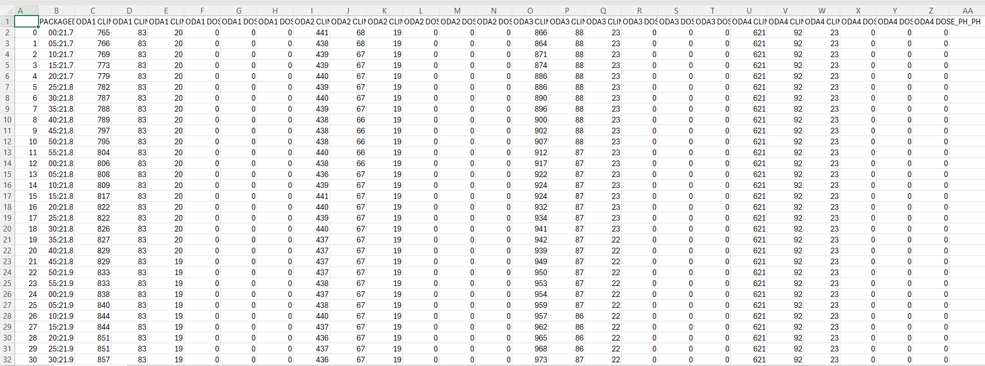
Dataset

Slide 14
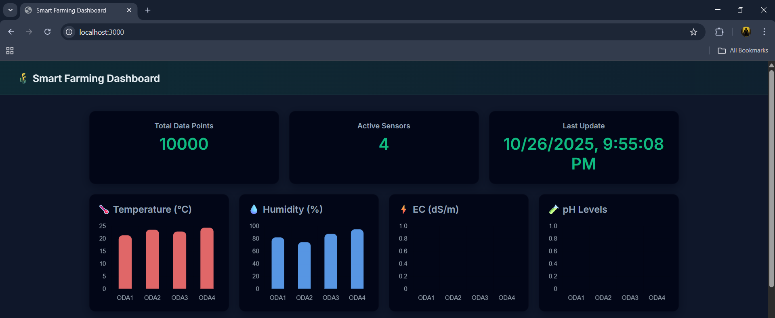
Output

Slide 15
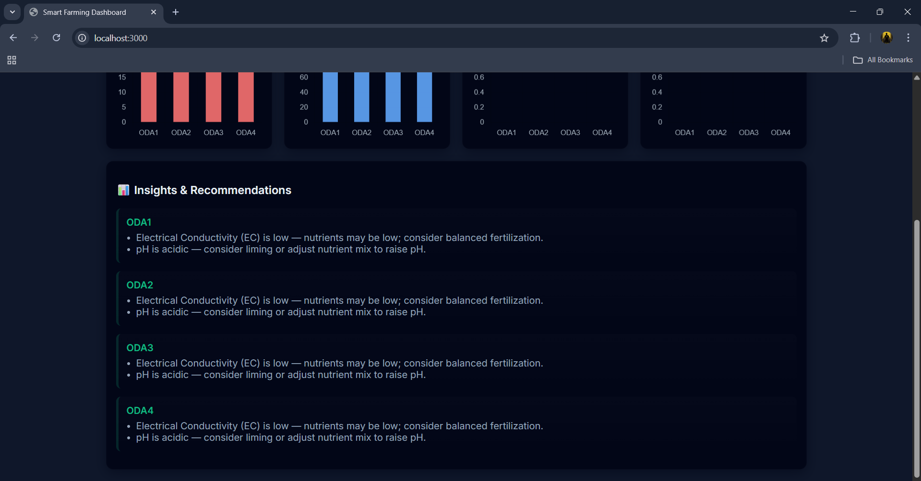
Output

Slide 16
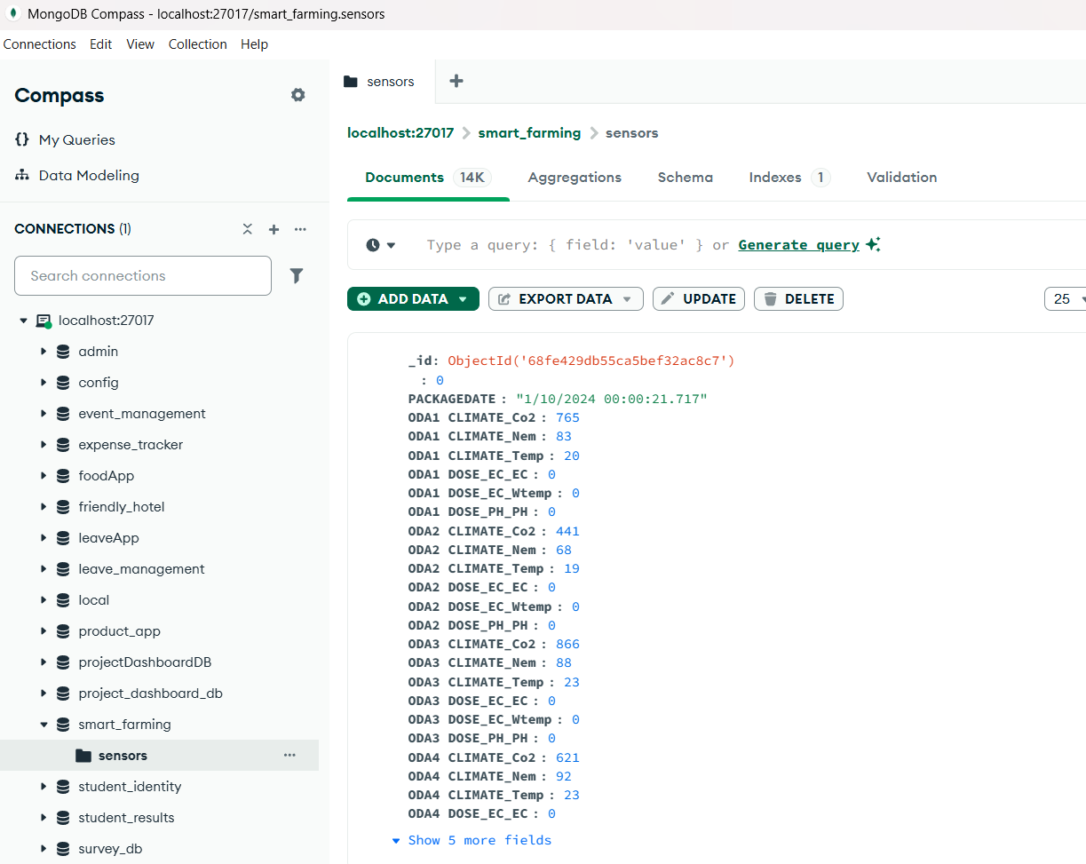
Database

Slide 17
Results & Benefits
Centralized farm data storage
Clear visual analytics for decision making
Automated recommendations
Scalable architecture (can add IoT sensors)
Easy to deploy on MongoDB Atlas + Render

Slide 18
Future Enhancements & Conclusion
Future Improvements:
  Real-time IoT sensor streaming
  AI/ML for yield prediction
  Weather API integration
  Mobile-friendly progressive web app
Conclusion:
  This project demonstrates how combining Node.js, MongoDB, and data visualization can make agriculture smarter, sustainable, and data-driven.

